Slide 1
The case for The Green New Deal
Ann Pettifor
7 April 2016 – Framing the Economic Narrative
www.primeeconomics.org

Slide 2
The case for the Green New Deal
Green New Deal Group

Slide 3
The Green New Deal Group
Larry Elliott, Economics Editor of the Guardian
Colin Hines, Co-Director of Finance for the Future
Tony Juniper, Environmentalist and Sustainability Consultant
Jeremy Leggett, founder and Chairman of Solar Century and SolarAid
Caroline Lucas, Green Party of England and Wales MEP
Richard Murphy, Co-Director of Finance for the Future and Director of Tax Research LLP
Ann Pettifor, former head of the Jubilee 2000, fellow, nef (new economics foundation) and director, Advocacy International
Charles Secrett, Advisor on Sustainable Development, former Director of Friends of the Earth
Andrew Simms, Policy Director of nef (the new economics foundation)
www.greennewdealgroup.org

Slide 4
What informed development of The Green New Deal in 2008?
The need to address triple crunch –
financial crisis
peak oil
climate change

Slide 5
The need to build an alliance between…
industry
Labour and
the green movement
….to challenge dominance of finance sector over the real economy and ecosystem

Slide 6
The need to adequately finance a response to the triple crises of
ongoing financial crisis
peak oil
climate change.

Slide 7
Above all, the need to transform the British economy away from fossil fuels – and all forms of carbon.

Slide 8
A just transition to a zero carbon, zero waste economy…

Slide 9
This means massive investment in:
Alternative energies – biomass, geothermal, hydroelectric, solar, wind…
Retrofitting Britain’s housing stock to end fuel poverty, cut bills via energy efficiency
Building flood defences

Slide 10
Transforming every building into a power station – decentralising the grid
Upgrading & diversifying Britain’s transport networks – especially railways - to make low-carbon travel a reality

Slide 11
Above all, the Green New Deal needs to mobilise ….
A ‘Carbon Army’ of ‘green collar’ skilled and unskilled workers
- scientists, architects, designers, engineers, builders, carpenters, technicians, plasterers etc…

Slide 12
Part of a shift….
…away from financial services and consumption as main drivers of the economy

Slide 13
John McDonnell: Fiscal Rules speech 11 March, 2016
“Our Fiscal Credibility Rule will provide us with the means to finance vital infrastructure, whether it is high-speed broadband or new rail connections in the North……

Slide 14
John McDonnell: Fiscal Rules speech 11 March, 2016
“……It is essential for our future prosperity that we retain the ability to borrow for investing in capital projects which over time will pay for themselves.”

Slide 15
The multiplier
IMF staff note that,
“despite their expected benefits, multipliers are not widely used by economists in operational work.”
(Eyraud and Weber, 2012, 2013).

Slide 16
The multiplier
IMF:
“……government investment, via the multiplier will then feed back in the form of higher tax revenues, because of the effect of investment on employment, incomes and GDP.”
(Eyraud and Weber, 2012, 2013).

Slide 17
In other words…
Public investment will pay for itself

Slide 18
“I’m afraid there’s no money.”
Liam Byrne MP, in a note for his successor when leaving the Treasury, 6 April 2010

Slide 19
“The state has no source of money, other than the money people earn themselves. If the state wishes to spend more it can only do so by borrowing your savings, or by taxing you more. And it’s no good thinking that someone else will pay. That someone else is you."
“There is no such thing as public money.
There is only taxpayers’ money.”
Mrs Thatcher, speech to Conservative Party Conference, October, 1983.

Slide 20
“We know that there is no such thing as public money – there is only taxpayers’ money”
David Cameron, on the campaign trail, 6 April, 2015.

Slide 21
Governor Mervyn King, Bank of England, October, 2009
“To paraphrase a great wartime leader, never in the field of financial endeavour has so much money been owed by so few to so many. And, one might add, so far with little real reform…"
He attacked the decision to prop up so-called casino banking, and described the £1trillion government support of the sector as "breathtaking".

Slide 22
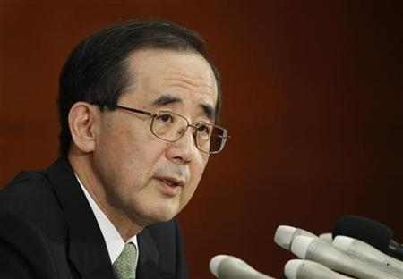
Governor Misaaki Shirakawa of the Bank of Japan
One week after Tsunami of March 11th, 2011 the Bank of Japan made more than €2.6 trillion (30 trillion yen) available for Japanese ‘reconstruction.

Slide 23
How to raise finance & increase national income ?
By the terribly simply idea that in cooperation with the monetary authorities – the Bank of England, the Treasury and the Debt Management Office (DMO)
the sale of valuable government assets – gilts or bonds (amongst the safest collateral in the world) – can, and do finance public works expenditures

Slide 24
And the equally simple reality
That, through the multiplier equation, the newly generated saving could be shown to be equal to the original expenditure.
In other words, the investment would “pay for itself "

Slide 25
Policy and the fiscal rule
Policy should not be about the design of fiscal rules

Slide 26
The Green New Deal approach?
We ask: what fiscal rule or rules are compatible with an economic strategy aimed at boosting national income - investment, economic activity, employment, wages and tax revenues – in order to finance The Green New Deal & tackle climate change?

Slide 27
The economic strategy?
With help of BoE and capital markets, raising
finance from gilt sales for the purpose of
“Investing in capital projects which over time will pay for themselves.” (John McDonnell 11 March, 2016)
Thereby eliminating slack, closing the output gap
Investing in the ‘green collar carbon army’
Upgrading skills, and raising incomes and wages

Slide 28
The result?
An increase in national income

Slide 29
Labour & Tory record: UK Investment vs G7
Source: World Bank

Slide 30
Total investment since 2007 as % GDP

Slide 31
We need at least £40bn p.a. for the Green New Deal
If Britain invested an additional £40bn a year to finance the Green New Deal – energy, transport, retrofitting buildings, flood protection - we would reach same level of investment as % of GDP as Germany and the US.

Slide 32
Public investment in 2016/17
= approx £73bn gross (about 4% GDP)
If this was raised by £40bn – to £115bn a year gross (about 6.0% GDP)…

Slide 33
Public investment of 6.5% of GDP
…would return public investment levels to those of the mid-Thatcher years.
In 1984-5 – gross investment was 6% of GDP.

Slide 36
Osborne: shrinking national income
Cuts in gross investment (of about £120bn – a fall from 5.5% of GDP to 3.9% (gross)
= slow recovery
= means government tax receipts so low that despite significant cuts to public services UK are set
to borrow over £50 billion more over 2015-16 than government originally planned.

Slide 37
“…..you will never balance the budget through measures which reduce the national income”
Keynes in conversation with Josiah Stamp on BBC, January, 1933.

Slide 38
Skilled, well-paid & full employment - key
Just as work – paid employment – makes things affordable for the individual,
so full, well-paid and skilled employment generates tax income and makes things affordable for government.

Slide 39
Osborne shrinking income.. falling wages
“…..real wages in the UK have declined and are still 5% lower than at the start of the recession, whereas in the US they increased.

Slide 40
“Fifty-five percent of the jobs created since 2008 are part-time….

Slide 41
“There has also been a sharp rise in the self-employment rate which is up 700,000, but more self-employment doesn’t seem to be better. A typical self-employed person is paid less than a typical employee….

Slide 42
The incomes of the self-employed are down 22% since the start of the recession. The self-employed are especially likely now to say they are underemployed.

Slide 43
Mark Carney, governor of the Bank of England, speech, 19 January, 2016. “The turn of the year”
“In the wake of the crisis, one reason that headline unemployment has not been a sufficient summary statistic for slack in the labour market is because of underemployment of those in work.

Slide 44
UK gives workers less employment protection than most of the 70 states the OECD monitors.
UK offers least protection, above only the US (no protection by OECD standards) and Canada.

Slide 45
“It looks more like a labour market disaster to me than a miracle.”
David Blanchflower, The Spectator, December, 2015

Slide 46
Falling incomes and wages reflected in rise in borrowing

Slide 47
The dominant economic model applied in the UK, but also in the world, is motivated by an arbitrary threshold for public debt set by, amongst others, economists Kenneth Rogoff and Carmen Reinhart in a 2010 paper:
Growth in a Time of Debt (NBER Working Paper No. 15639, January 2010).

Slide 48
Rogoff and Reinhart
The authors assume that “taxes ultimately need to be raised to achieve debt sustainability” . They then go on to acknowledge “that the distortionary impact (of raised taxes) is likely to lower potential output.”

Slide 49
Rogoff and Reinhart
They argue
“that governments can also tighten by reducing spending ….
And then acknowledge that reducing spending
“can also be contractionary.”

Slide 50
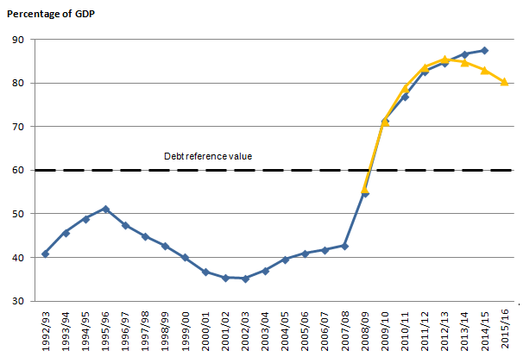
Government debt as % GDP, Maastricht definition

Slide 51
Disinflation, noflation, deflation
In April 2015, the UK slipped into deflation when prices fell by 0.1% in the year to April.

Slide 52
Dangerous deflationary pressures
In a deflationary environment .. where prices, profits and wages fall, the real value of debt, and the cost of debt repayments rises - inexorably.
And there are very few tools left in the BoE’s monetary toolbox with which to deal…

Slide 53
So, what must be done to raise national income, revive the economy and finance The Green New Deal?

Slide 54
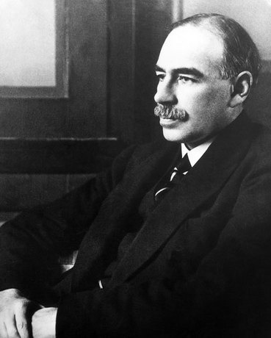
Keynesian monetary tools for recovery:
Move offshore capitalism back onshore –
Robin Hood taxes – taxing financial flows

Slide 55
Keynesian monetary tools for recovery:
Fix the banks – separate speculative from retail banking
Manage the financial system
Orderly re-structuring of unpayable private debts

Slide 56
Keynesian monetary tools for recovery:
BoE’s QE: ‘open market monetary operations’ a core instrument since 1694 – supports government in secondary markets in financing sustainable green projects, employment & income generation.

Slide 57
Keynesian monetary tools for recovery:
Low Interest rates –
for all loans, not just inter- bank loans – ‘the bank rate’
For safe, risky, short & long-term loans needed by cornershops, innovators, green entrepreneurs.

Slide 58
Keynesian monetary tools for recovery:
Public investment to increase national income at a time of demand deficiency
Multiplier deployed so investment pays for itself.

Slide 59
It can be done.

Slide 60
What we can do, we can afford.
What we can do - within the limits of our imagination, intelligence, muscle, and within the limits of both the economy and the ecosystem – we can afford.

Slide 61
The case for the Green New Deal
Green New Deal Group

Slide 62
Ann Pettifor
Director of Policy Research in MacroEconomics
www.primeeconomics.org
@AnnPettifor

